Slide 1
Scheme Rules

Slide 2
Intersectionality of Scheme Design and Technical Design
Other Enablers (i.e. Infrastructures, Market Characteristics, Programs)
Business decisions drive technical design
Isolating technology from business results in misaligned outcomes
Law and regulation influence all aspects of the System (business and technical)
Outside of the payments ecosystem, other enablers influence how a system is shaped
Business Design and Rules
Technical Design
Law and Regulation
Source: BMGF: L1P

Slide 3
An Instant Payments System Includes a Scheme and a Platform

Slide 4
Criticality of Designing for Inclusivity Across All Aspects
Source: Glenbrook analysis from respective payment system data.

Slide 5
Codifying Scheme Decisions
Scheme Rules | The rules governing entities’ activities within the IIPS Scheme and how they interact with the Platform The scheme rules provide a robust ruleset for participation and engagement There may also be multiple appendices which contain additional detail
Participation (and Other) Agreements | The contract between the Scheme Owner and a Participant, binding both parties to the unique aspects of the Scheme Rules Different Agreements are developed for different Participant Types Other Agreements may also be developed for other non-Participant entities (e.g., Payment Initiation, Technology Provider)
Source: BMGF: L1P

Slide 6
The Mojaloop Scheme Ruleset
To ensure implementation teams have a cohesive and inclusive scheme rules, the community has created a ‘Plug and Play’ ruleset for Mojaloop implementers that
Reflects inclusive design principles
Aligns to Mojaloop POC design decisions
Provides a starting point for a final ruleset with guidance on how to mature it as implementers shift from POC to Full Implementation to Go Live to Expansion
Table of Contents
Definitions
Document Information
Scheme Context
Scheme Definition, Scope, and Services
Legal Framework and Governance
Entity Roles and Responsibilities
Operating Model
Clearing
Settlement
Addressing
Dispute Management
Reporting
Participant Portal
Fees
Participant Application
Flow Diagrams
Source: BMGF: L1P

Slide 7
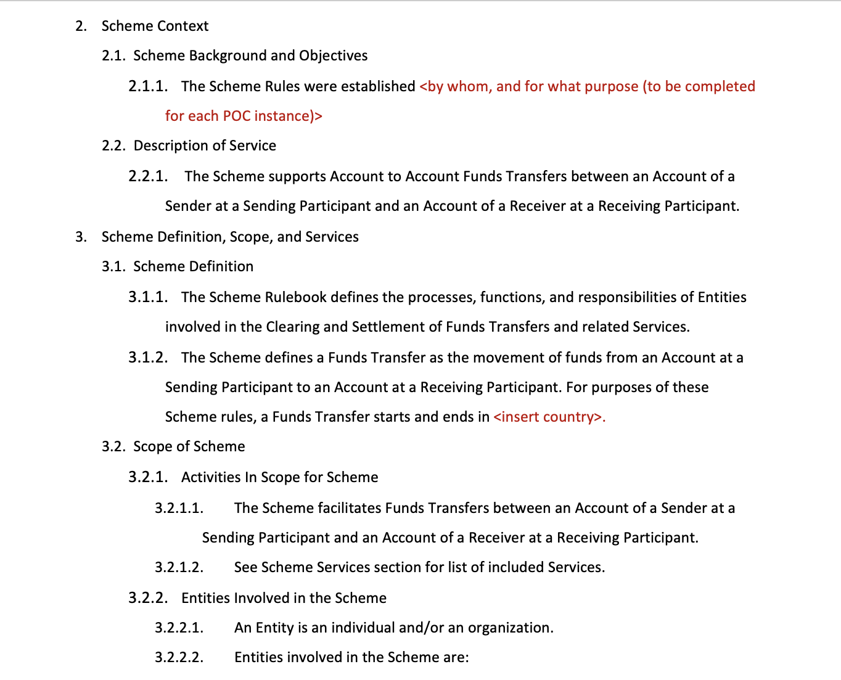
What Does the Document Look Like?
Legend
Black text – plug and play text
Minimal red text - Content to be filled in with specifics for each POC
Blue text – insights to implementation teams on additional considerations for IIPS Schemes more broadly
Source: BMGF: L1P

Slide 8
Let’s Walk Through an Example: Entity Types
Entities involved in the Scheme are:
Scheme Manager. The Entity designated to oversee the Scheme. The Scheme Manager engages with Entities involved in the Scheme through the Scheme Governance structure to maintain the Scheme rules.
Payment Hub Operator. The Entity designated to manage and operate the Payment Hub, which is the technology used to perform Clearing. The Payment Hub may provide additional Services beyond Clearing.
Participant. An Entity that provides Accounts to End Users, is bound by the Rulebook, and is authorized to send and receive Value and Non-Value Messages via the Payment Hub in support of a Funds Transfer.
Direct Participant. A Participant that is authorized to have a direct Settlement Account with the Settlement Bank. A Direct Participant may play the role of Sending or Receiving Participant.
Indirect Participant. A Participant that is not authorized to have a direct Settlement Account with the Settlement Bank. An Indirect Participant may rely on a Direct Participant for Settlement. May play the role of Sending or Receiving Participant.
Settlement Bank. A central bank or commercial bank used to affect Settlement. <provide specifics for the bank serving this function for each POC>
End User. An End User is a Sender or a Receiver. An End User will be an individual.

Slide 9
Let’s Walk Through an Example: Entity Roles
The execution of a Funds Transfer involves the following Entities. Each definition applies to each Entity in accordance with its role in a particular Funds Transfer.
Sender. An End User that initiates a Funds Transfer.
Sending Participant. A Participant that provides an Account to the Sender and is responsible for supporting a Funds Transfer for the Sender.
Payment Hub. The technology used to perform Clearing. The Payment Hub may provide additional Services beyond Clearing.
Receiving Participant. A Participant that provides an Account to the Receiver and is responsible for supporting a Funds Transfer for the Receiver.
Receiver. An End User that is the beneficiary of funds sent through a Funds Transfer.
Settlement Bank. A central bank or commercial bank used to affect Settlement through Settlement Accounts held by Direct Participants. The Settlement Bank for the Scheme is <provide specifics for the bank serving this function for each POC>

Slide 10
Let’s Walk Through an Example: Entity Responsibilities
Participants Responsibilities
A Participant must be licensed to by <insert relevant regulatory agency>.
A Participant can play the role of Sending Participant and as a Receiving Participant.
A Participant must connect to the Payment Hub to perform its roles and responsibilities.
A Participant must be able to initiate and receive all Value and Non-Value Messages in support of the Funds Transfer flows relevant to its role as Direct or Indirect Participant.
A Participant must support the Channels outlined in this Rulebook.
A Participant must be able to access the Participant Portal.
A Participant must have sufficient and appropriate staff to perform its roles and responsibilities in accordance with the Rulebook.
A Participant must pay all relevant Fees according to the terms outlined in this Rulebook.
A Participant must sign a Participation Agreement and any other relevant Agreement required to perform specific roles.
The Scheme defines two types of Participants. Additional roles and responsibilities apply to each Participant type:
Direct Participant. A Participant that is authorized to have a direct Settlement Account with the Settlement Bank.
A Direct Participant must be able to exchange messages with the Settlement Bank to execute Settlement.
A Direct Participant may serve as a Settlement Sponsor to an Indirect Participant.
A Direct Participant that serves as a Settlement Sponsor to an Indirect Participant must register each Indirect Participant it Sponsors (Sponsored Participant) with the Scheme.
Indirect Participant. A Participant that is not authorized to have a direct Settlement Account with the Settlement Bank. An Indirect Participant must rely on a Direct Participant for Settlement.
An Indirect Participant must use a Direct Participant to serve as its Settlement Sponsor.
An Indirect Participant must be able to exchange messages with the Direct Participant to execute Settlement.
An Indirect Participant must be registered with the Scheme as a Sponsored Participant.

Slide 11
Let’s Walk Through an Example: Expanding on Roles after the POC
Scheme Manager and Payment Hub Operator may be the same or different Entities. This needs to be defined for each Scheme:
Different Types of Participants. Note that there is no single definition of Participant that applies equally to each Scheme and thus, the definitions provided for the POC may need to be refined or expanded, and other definitions may need to be added. Schemes may define Direct and Indirect Participants differently and may identify other/additional categories of Participants. The definitions included in this Rulebook are based on current understanding of the list of Participants. It is critical that the Scheme is precise in its definitions and in clearly outlining the roles and responsibilities of each type of Participant.
Technical Service Provider (TSP). A Service Provider that provides the technical connection to the Payment Hub for a Participant and may provide other supporting services. A Technical Service Provider is typically required to adhere to the rules defined in the Technical Service Provider Agreement and other relevant SLAs. In addition, there are sometimes rules in the Scheme Rulebook for Technical Service Providers. If you create a TSP role, it is important to note in the Rulebook that reliance on a TSP by a Participant does not relieve the Participant from its full obligations defined in the Rulebook.
Payment Initiator Service Provider (PISP). An Entity that is authorized to connect directly to the Payment Hub for the purposes of sending and receiving messages on behalf of the End User. A Payment Initiator is not a Participant but is bound to rules outlined in the Payment Initiator Agreement. Typically, a Payment Initiator does not provide End User Accounts, but can provide the interface for End Users to initiate a Funds Transfer.

Slide 12
Next Steps
The community is finalizing the ruleset in the next two weeks, which will be made available on GitHub
We welcome any comments and feedback to help mature/evolve/expand the document

